Slide 1


Google Machine Learning courses
Notes:
https://developers.google.com/machine-learning/crash-course

Slide 2
What you will learn
Linear Regression
Logistic Regression
Classification
Working with Numerical Data
Working with Categorical Data
Datasets, Generalization, and Overfitting
Neural Networks
Embeddings
Large Language Models
Production ML Systems
AutoML
ML Fairness

Slide 3
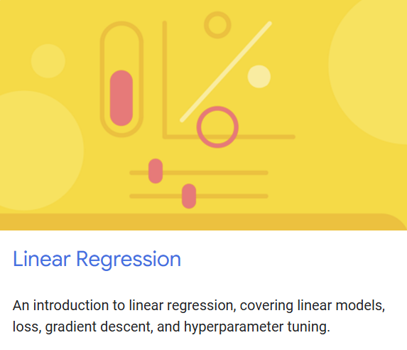
Linear regression
Notes:
https://developers.google.com/machine-learning/crash-course/linear-regression

Slide 4




Notes:
https://www.youtube.com/channel/UC35ZpwldGw7ZJ5R-2sLijzw

Slide 5
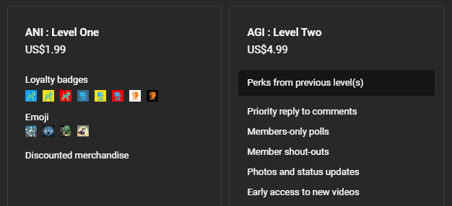
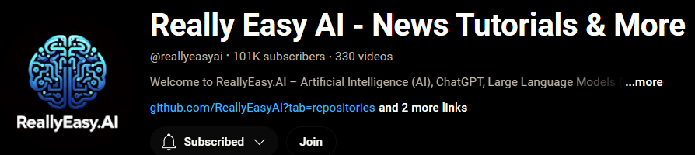
Membership has its privileges
Notes:
https://www.youtube.com/channel/UC35ZpwldGw7ZJ5R-2sLijzw/join

Slide 6

https://www.youtube.com/@AINewsFresh

Slide 7

https://www.youtube.com/@DailyAINewsPodcast

Slide 8

https://www.youtube.com/@AIPapersPodcastDaily

Slide 9
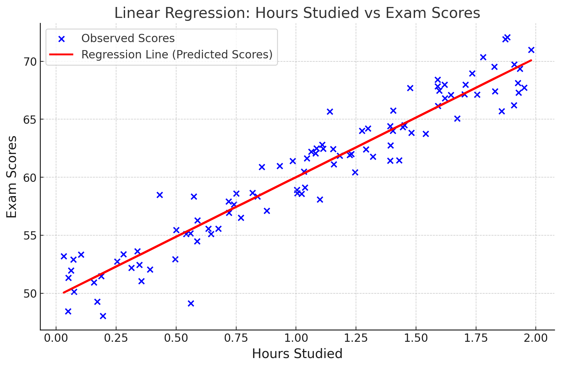

Slide 10
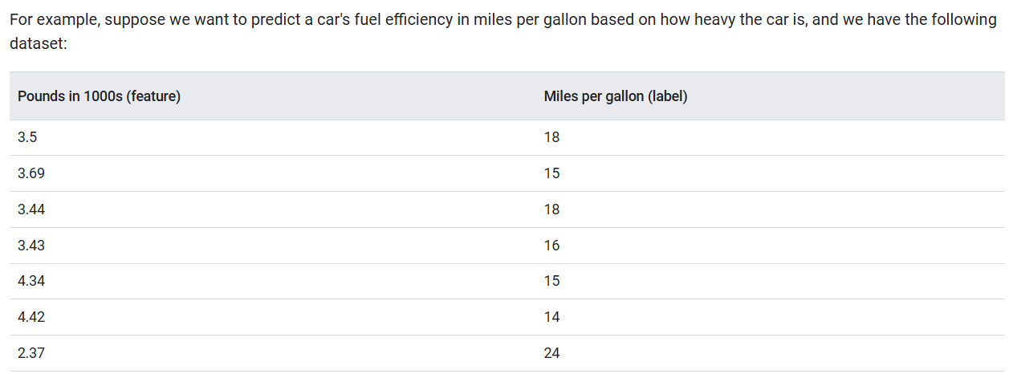

Slide 11
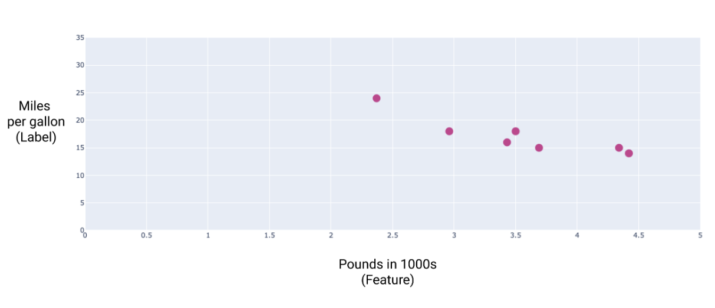

Slide 12
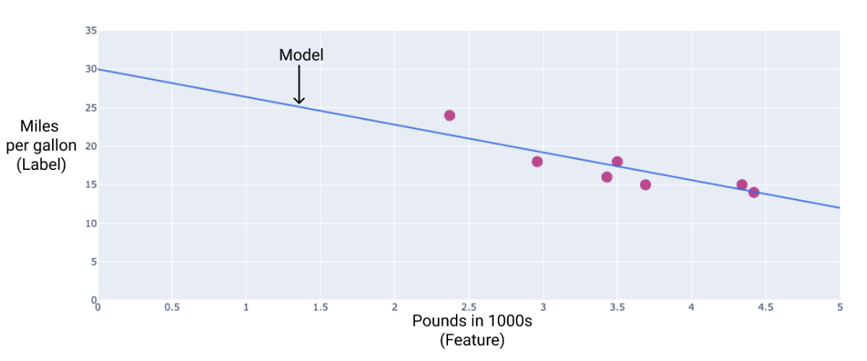

Slide 13
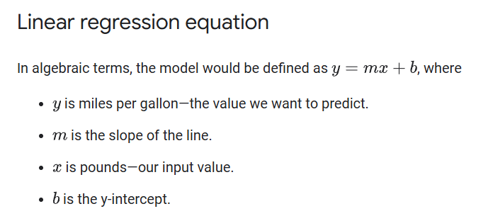

Slide 14
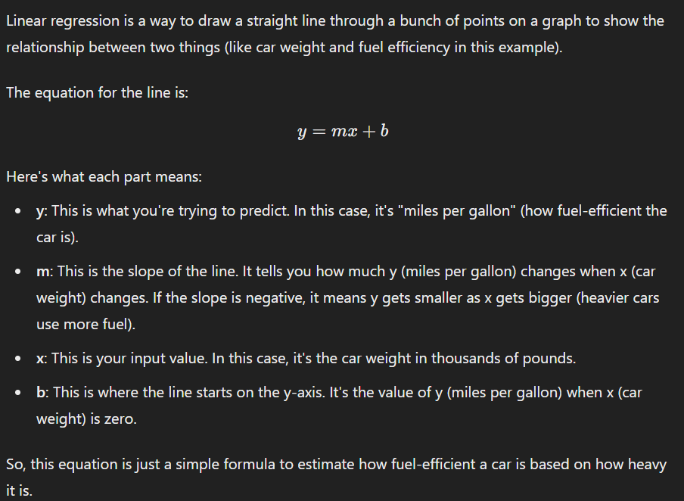

Slide 15

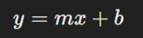

Slide 16


Slide 17
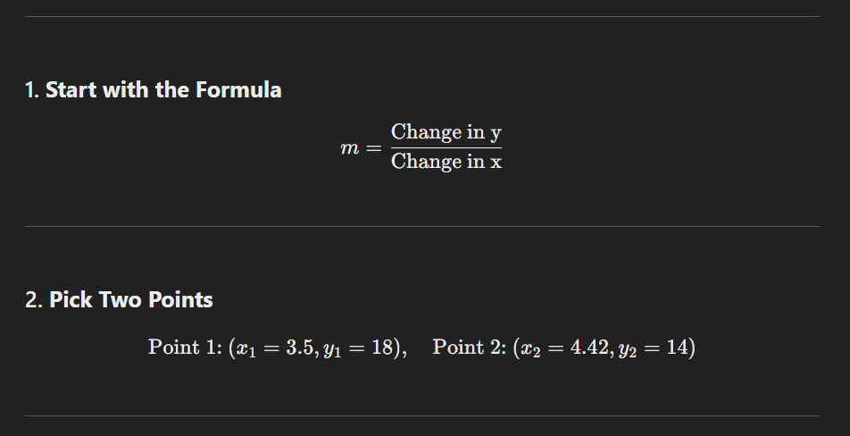
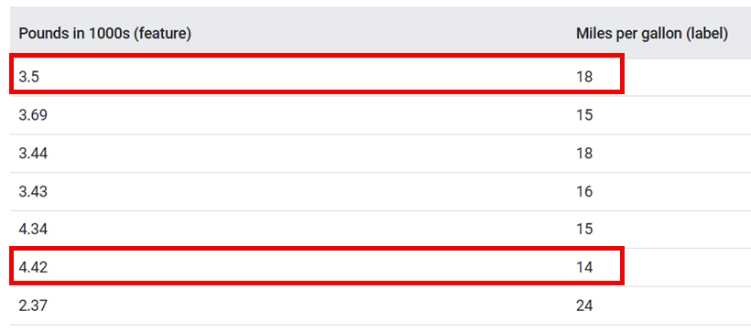

Slide 18
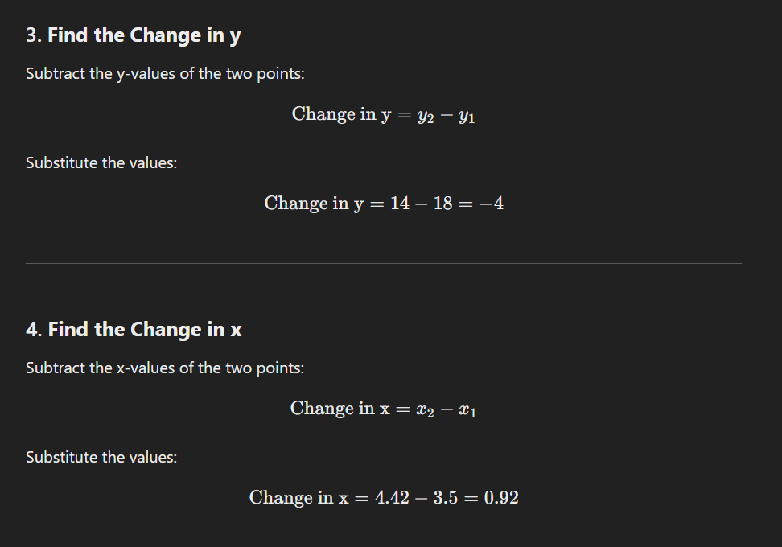

Slide 19
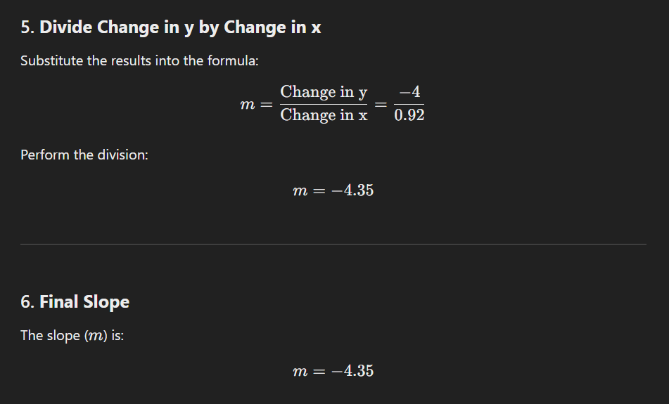

Slide 20


Slide 21

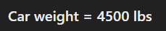
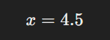

Slide 22


Slide 23
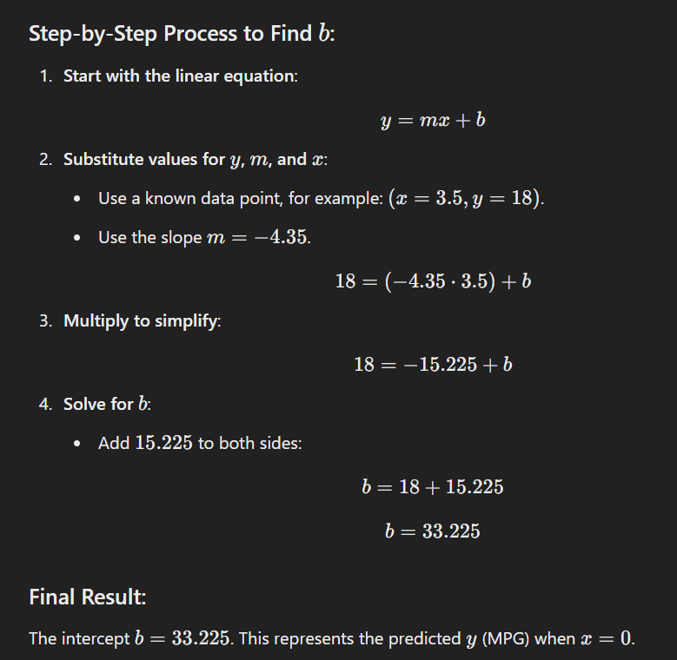

Slide 24
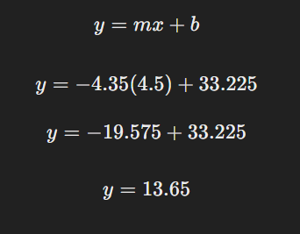

Slide 25
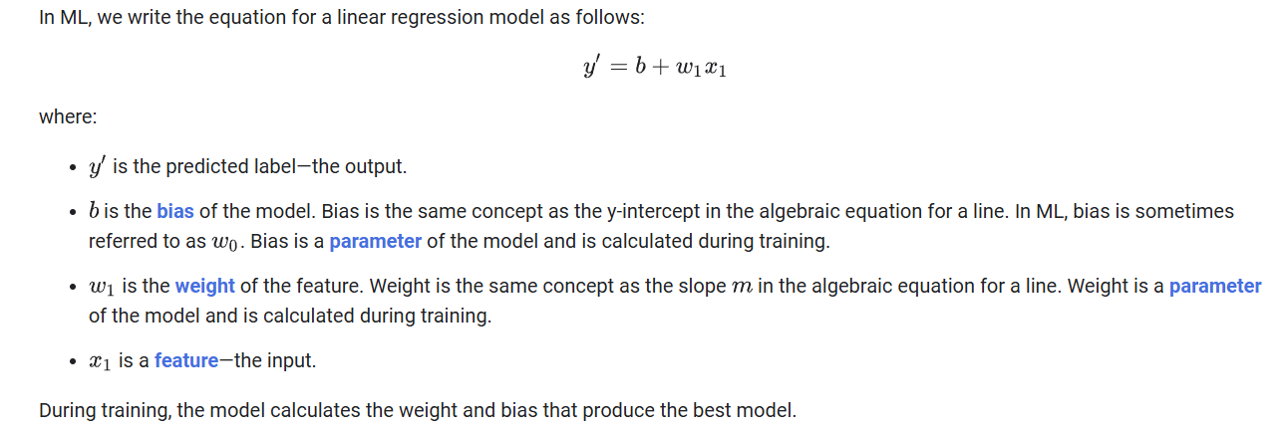

Slide 26
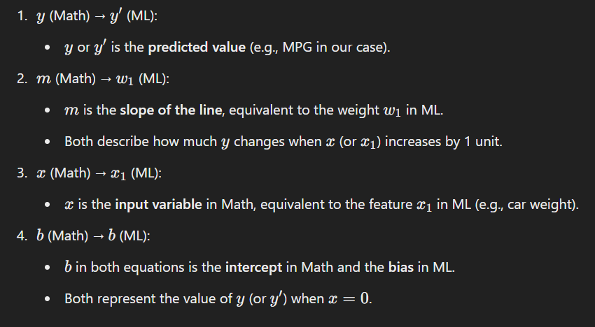
Same stuff, different names

Slide 27
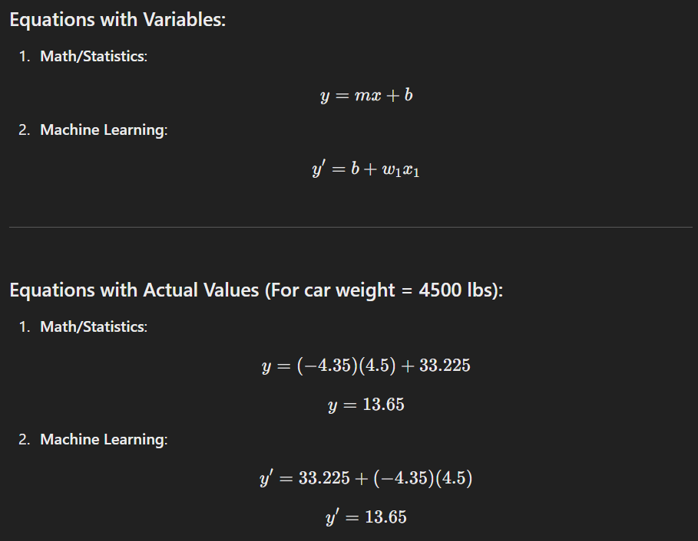

Slide 28
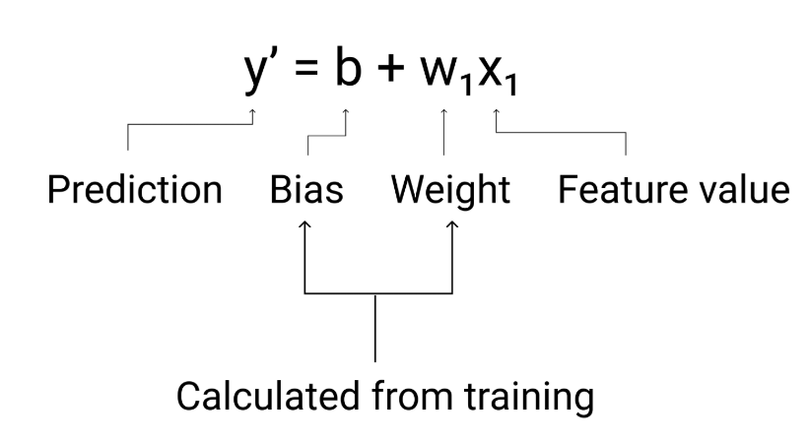

Slide 29
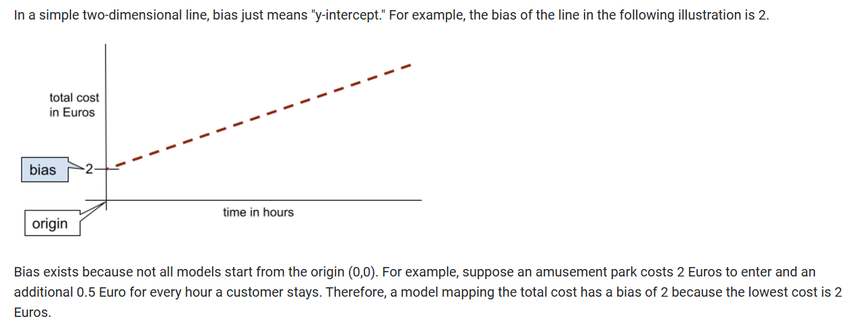

Slide 30
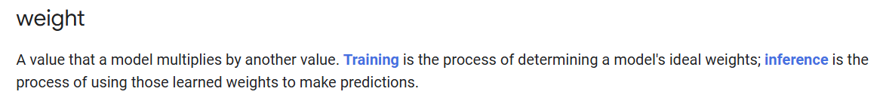
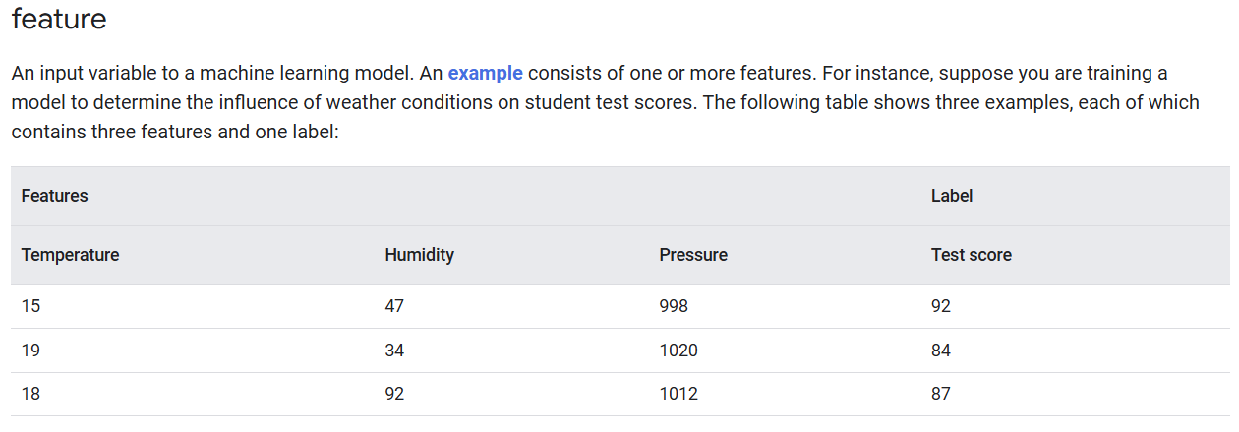

Slide 31
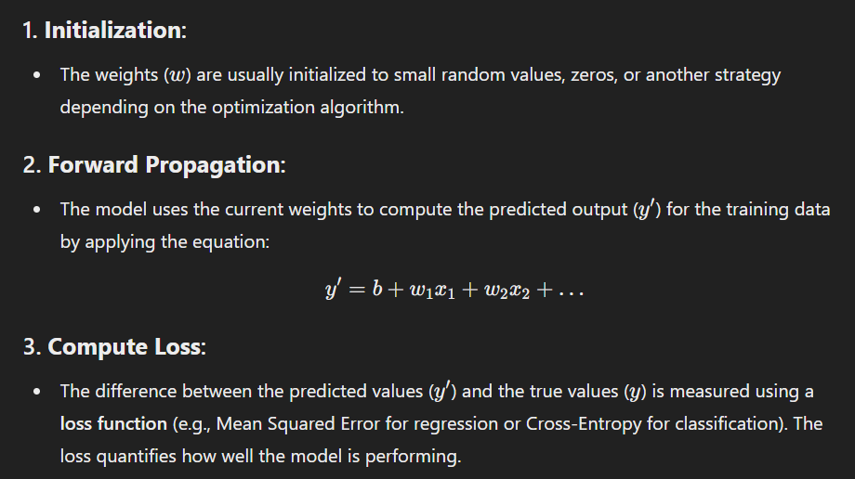

Slide 32
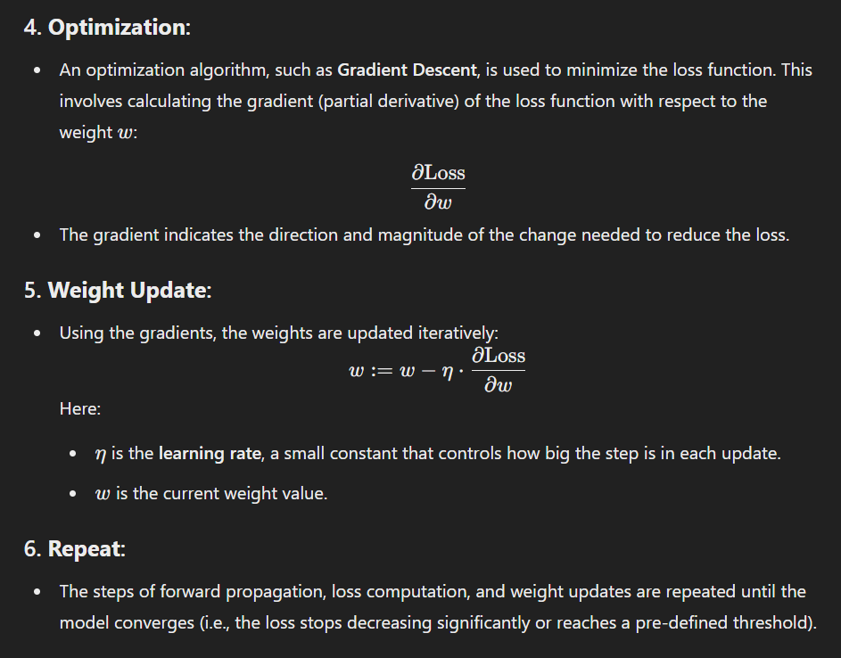

Slide 33
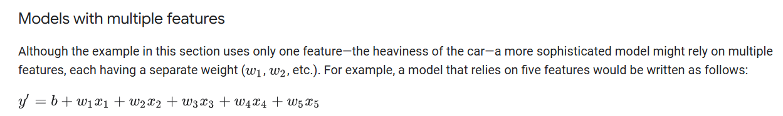

Slide 34
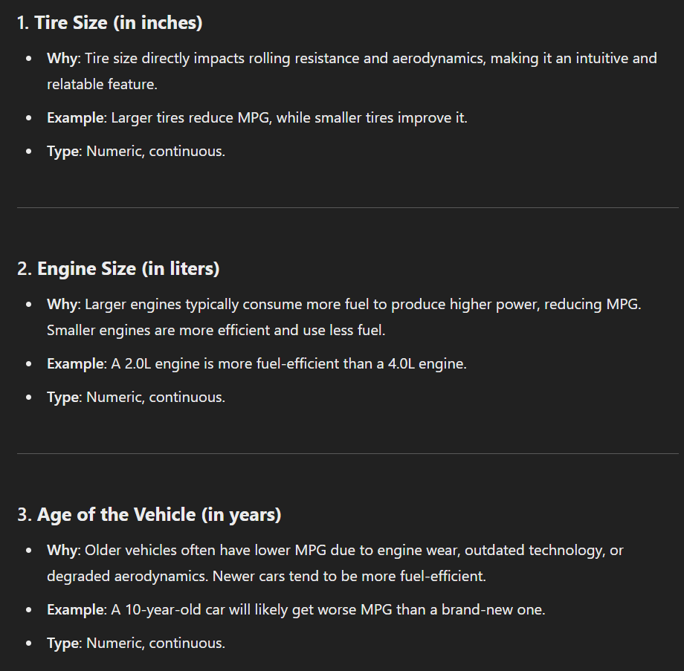

Slide 35
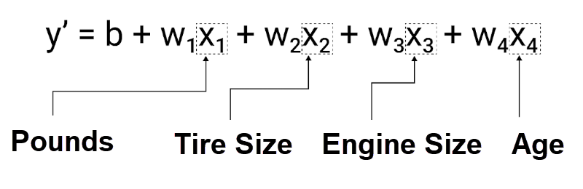

Slide 36
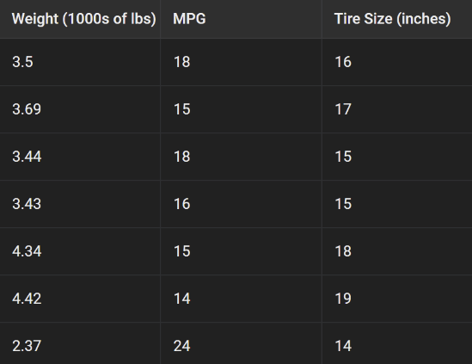

Slide 37
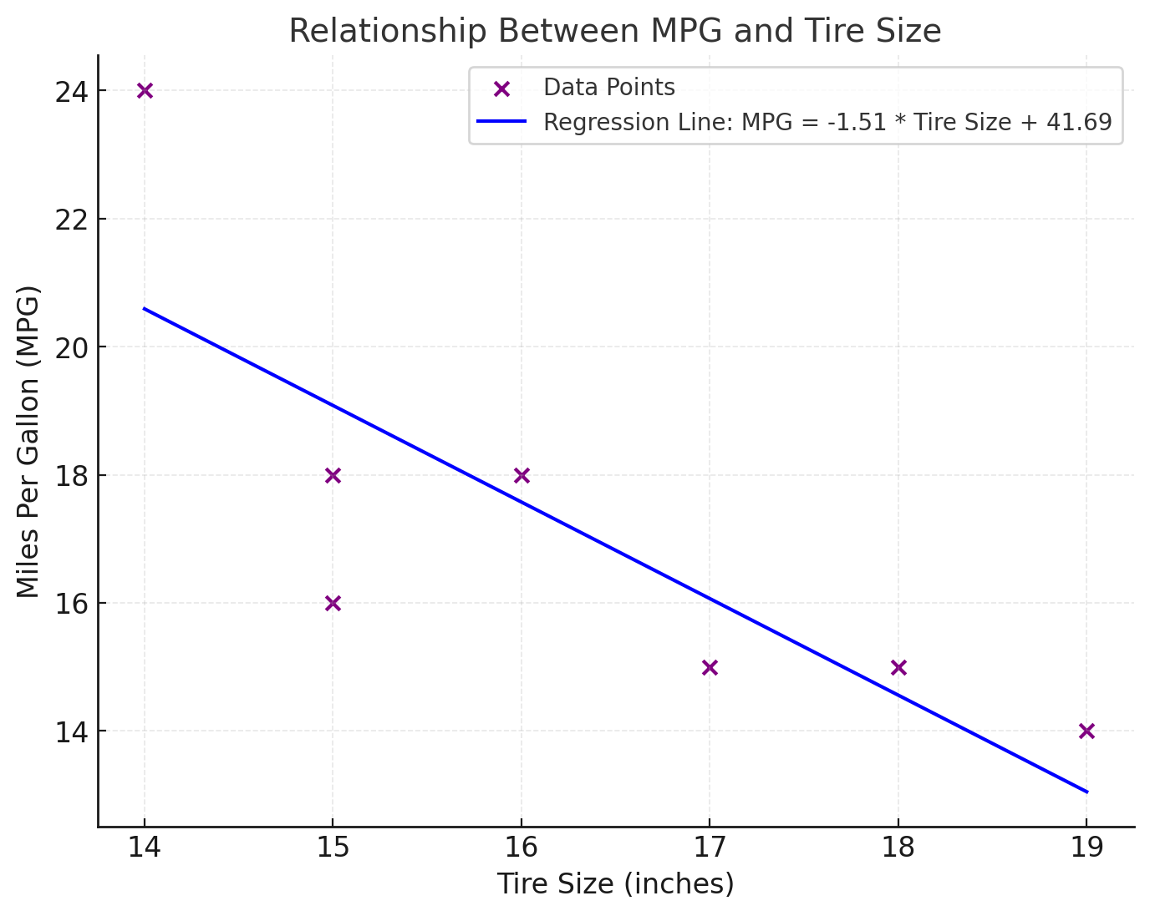

Slide 38
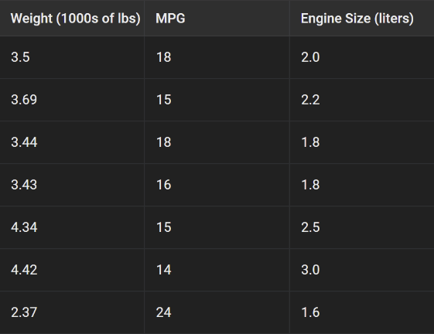

Slide 39
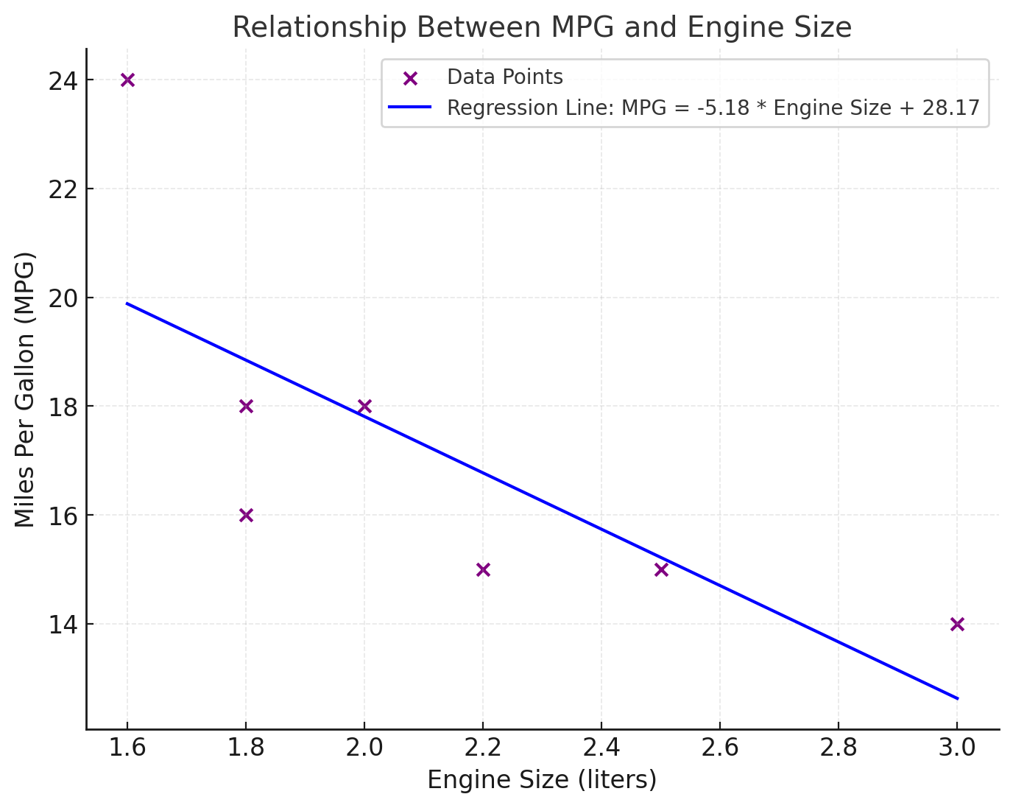

Slide 40
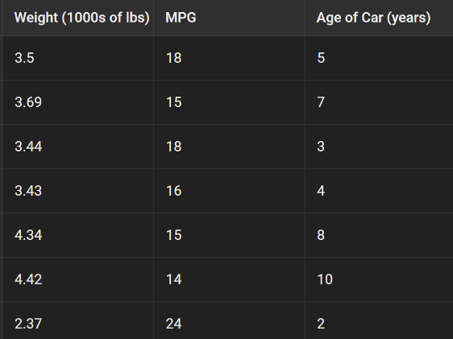

Slide 41
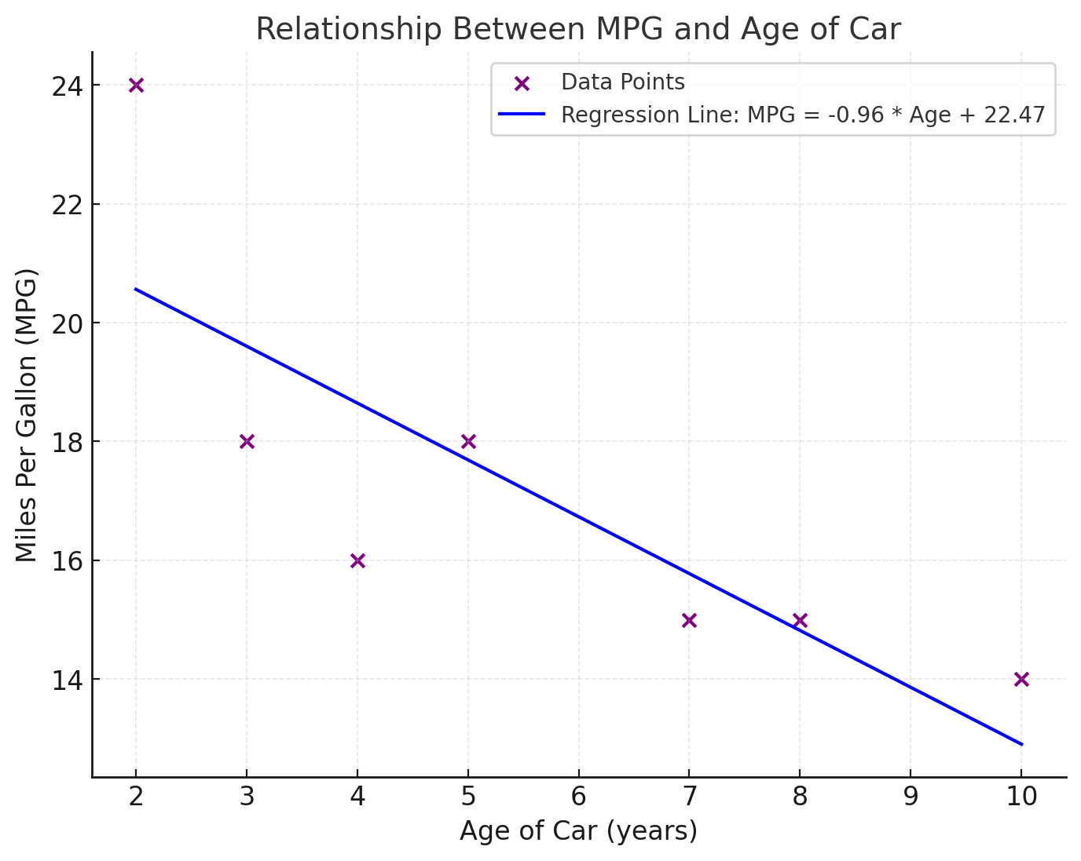

Slide 42
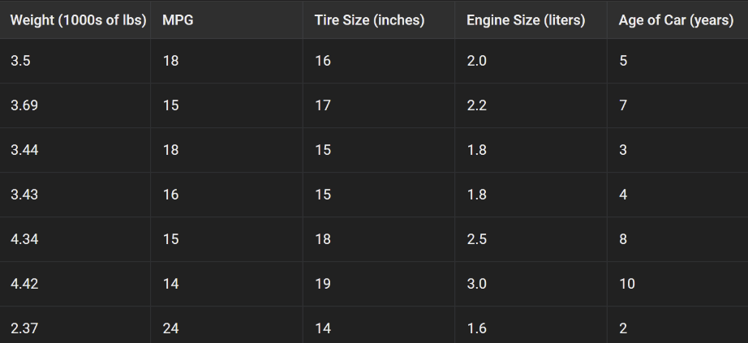

Slide 43
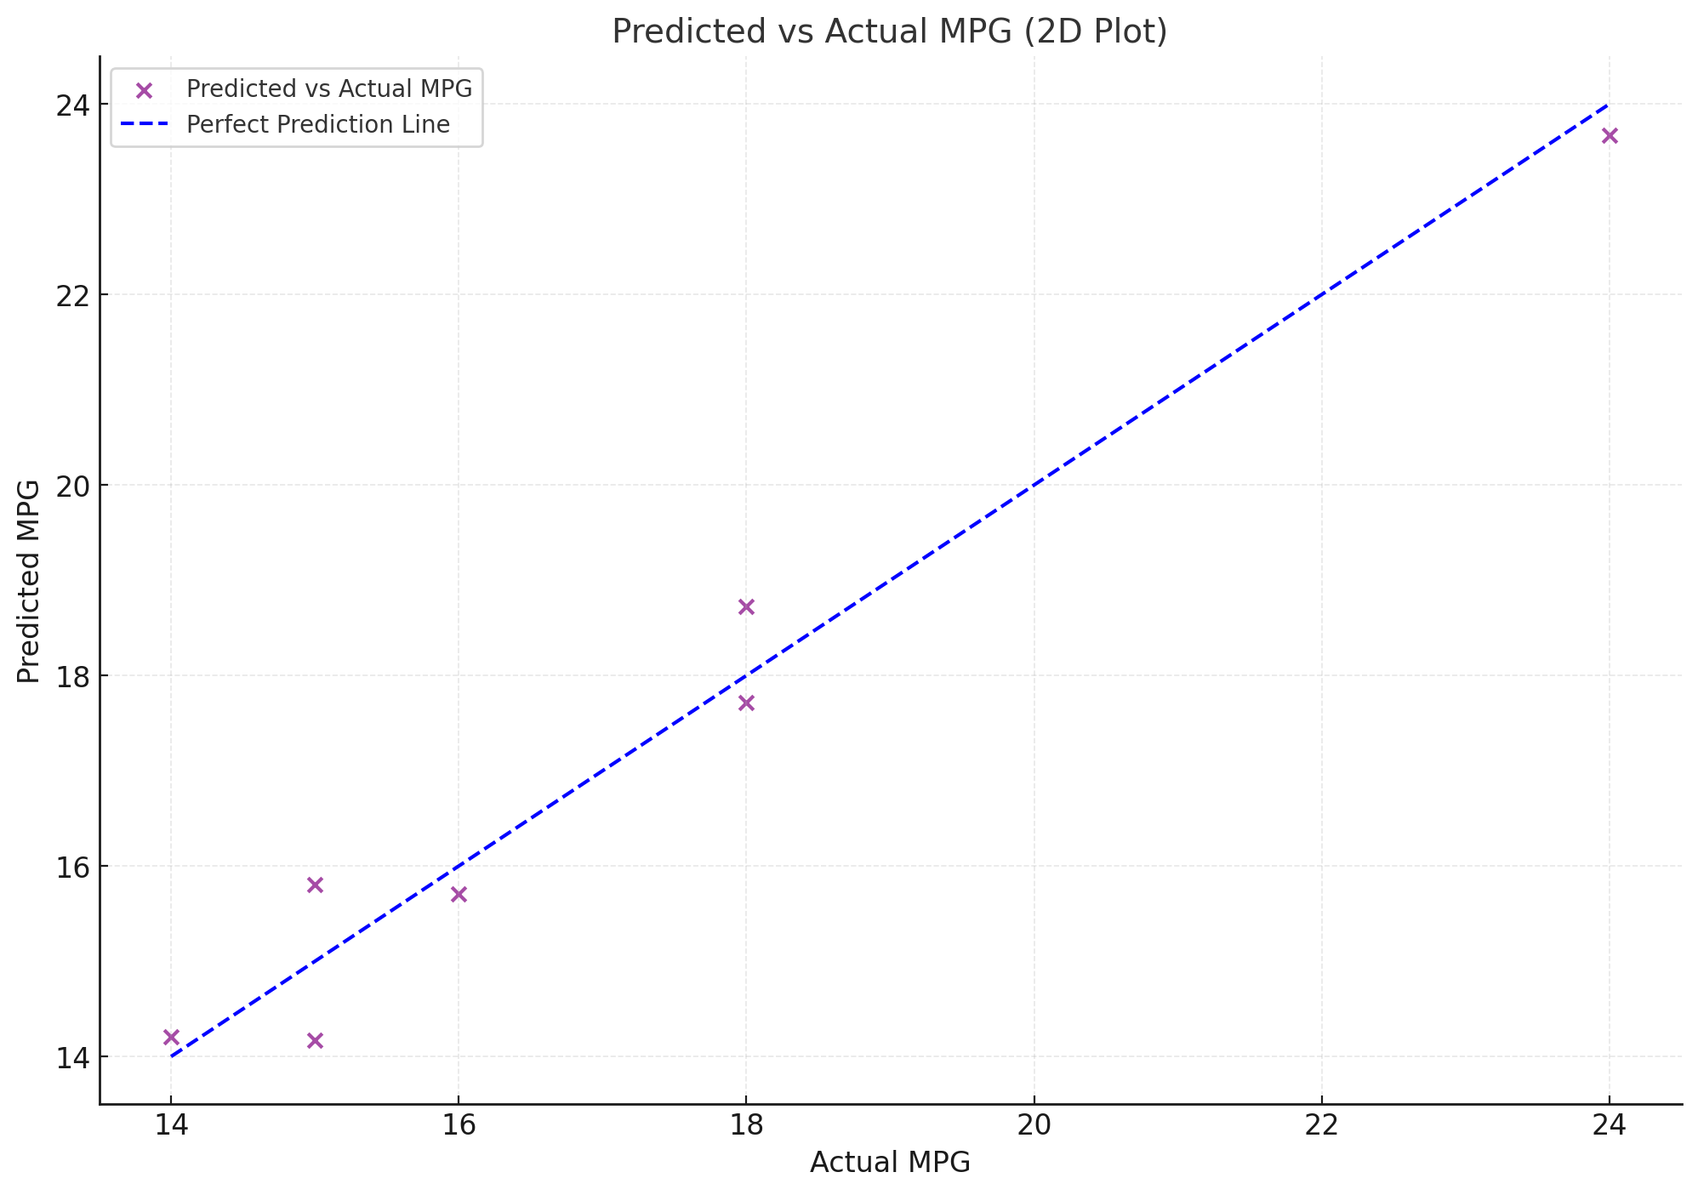

Slide 44
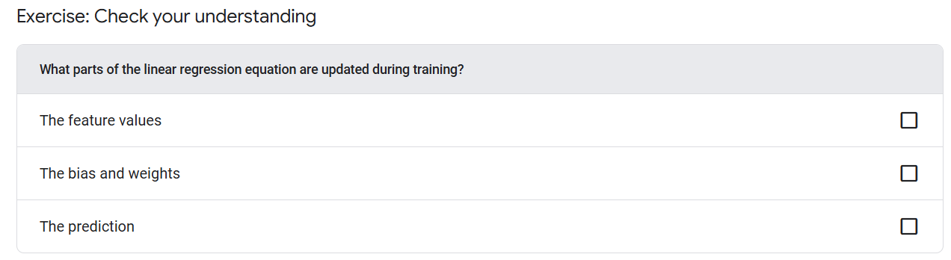

Slide 45
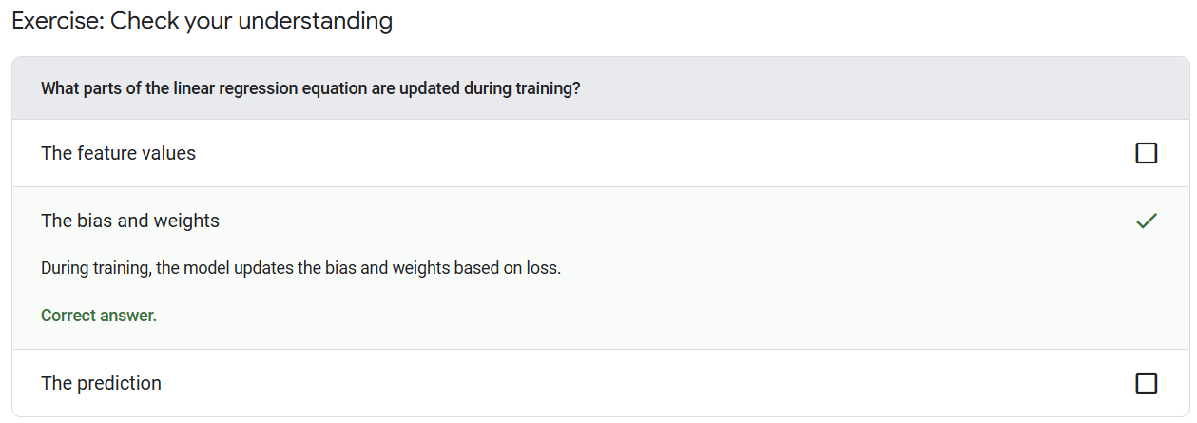

Slide 46
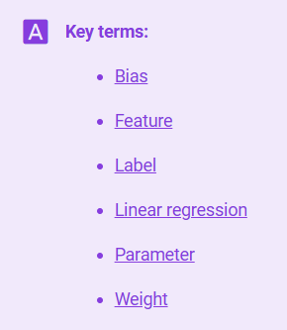
Notes:
https://developers.google.com/machine-learning/glossary

Slide 47


